Slide 1
Prediction Competition
Zoe Douglas, Jovanne Saldierna, Chris Hishmeh, Blake Shabshab

Slide 2
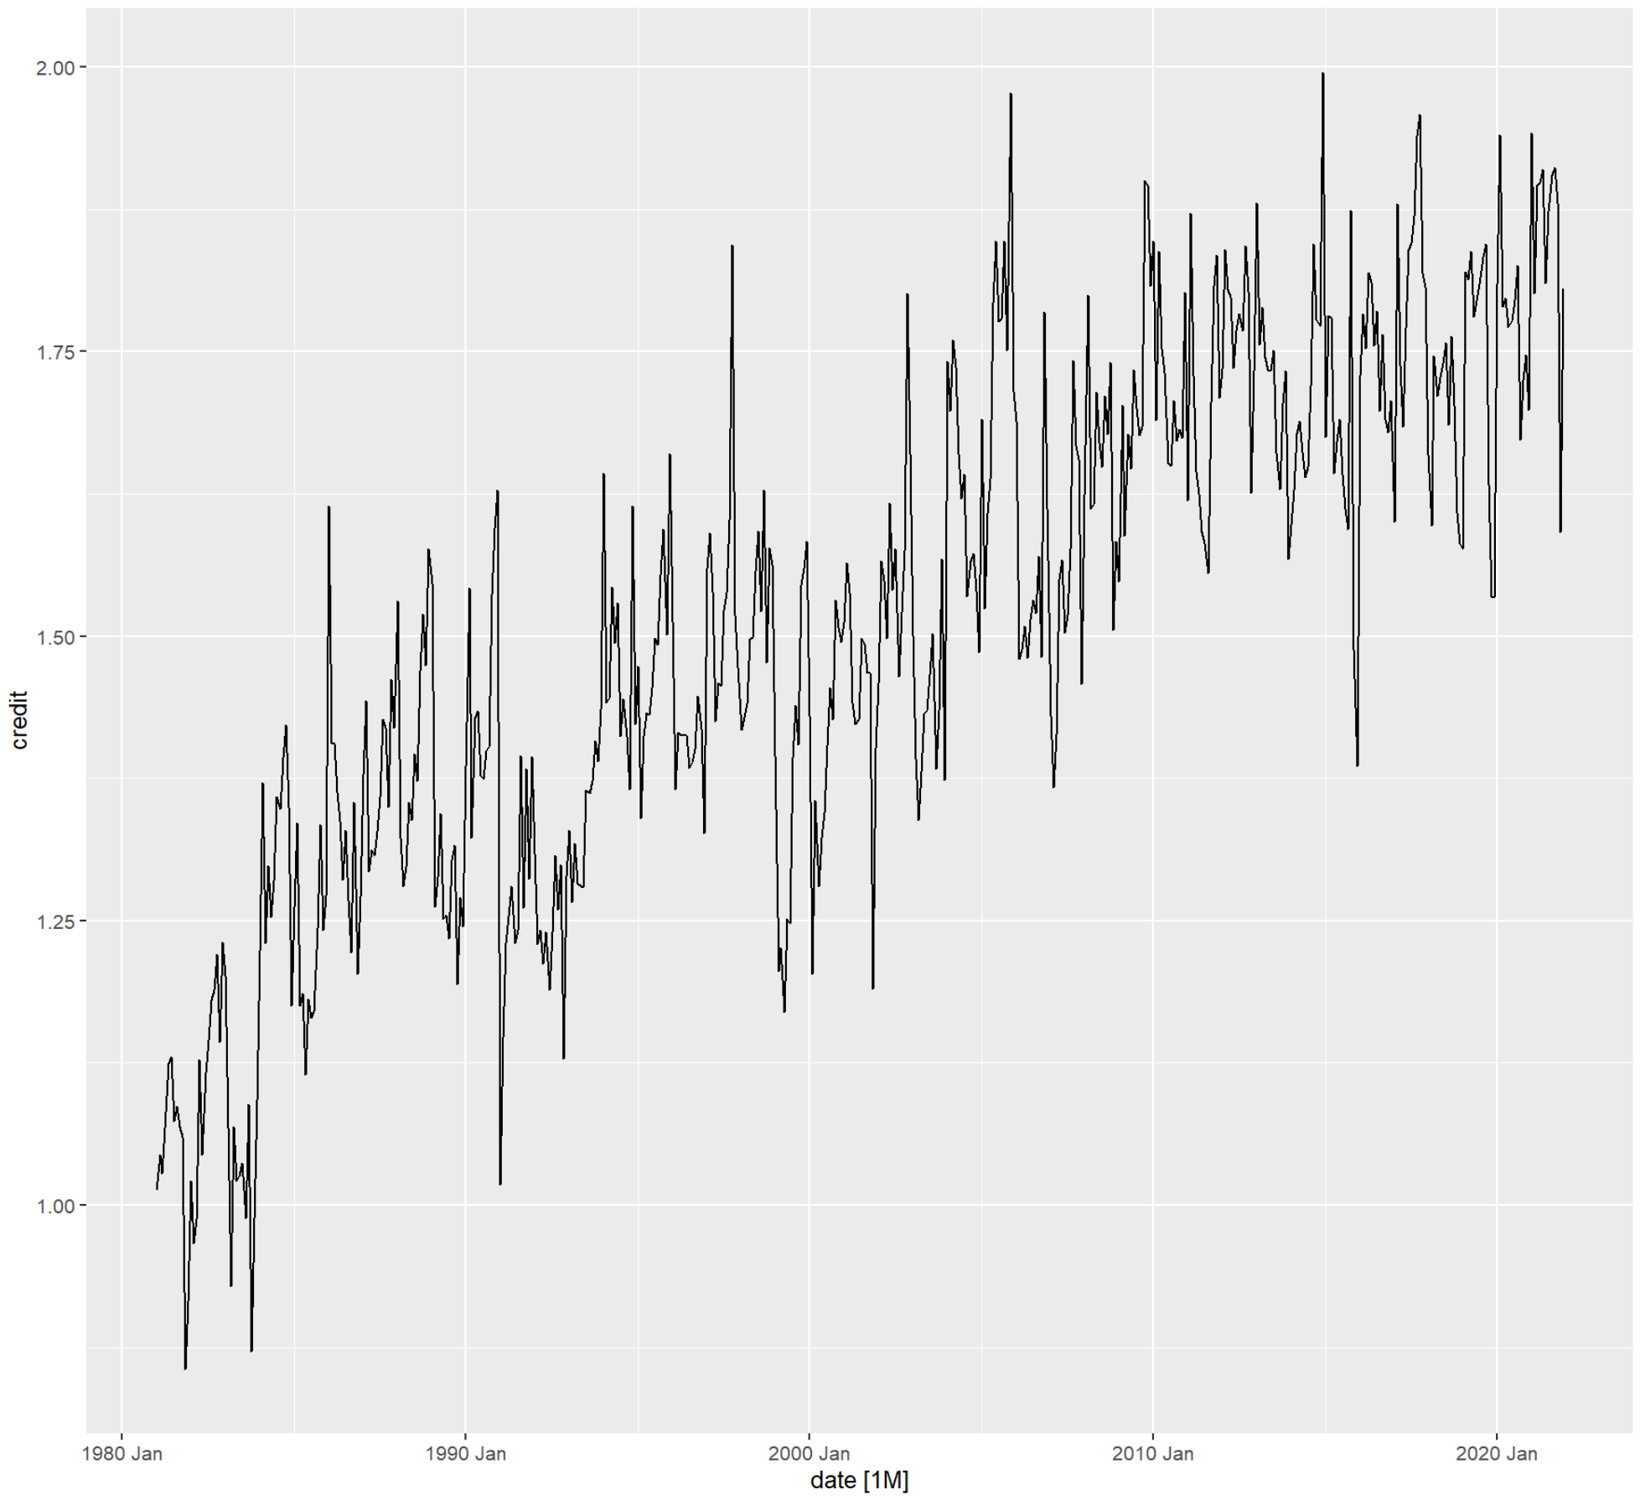
A look at our data
This is a plot of our Imperial Credits over 41 years. You can easily make out its upwards trend (it’s tendency to increase in value) with sharp peaks and lows at times.
It looks like we may have some seasonality in the mix, let’s take a look from a better vantage point to find out.

Slide 3
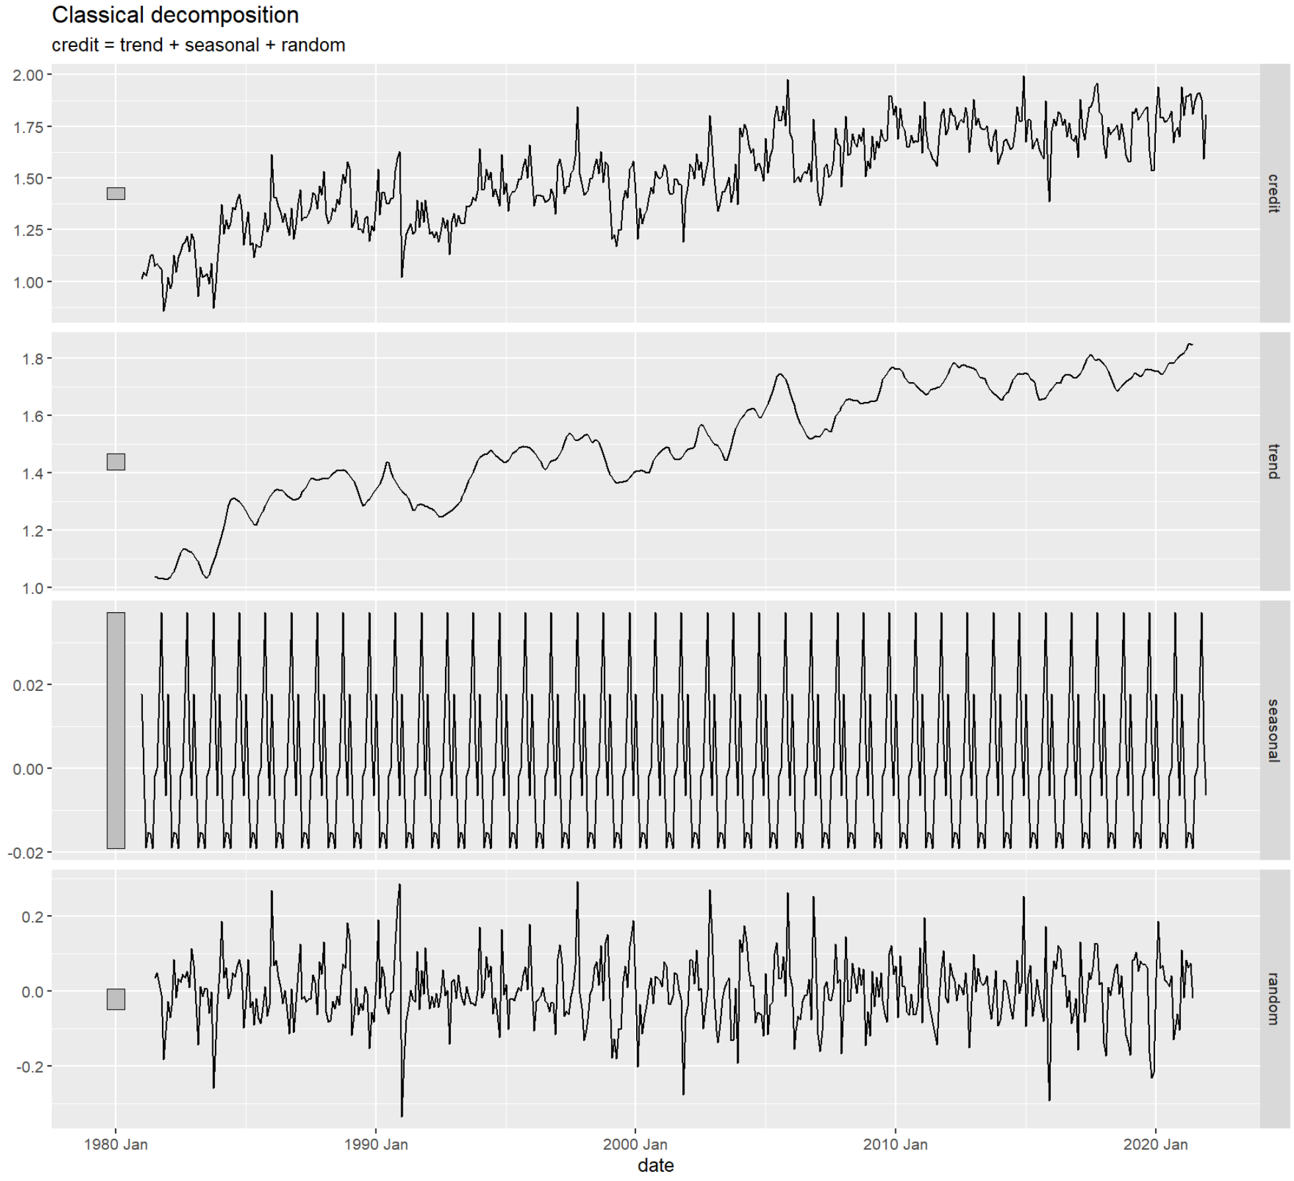
Decomposition of the Data
There is an increasing trend in the decomposition of the data. The trend is an important factor of the decomposition.
The seasonality is not an influential factor
There is almost no seasonality

Slide 4
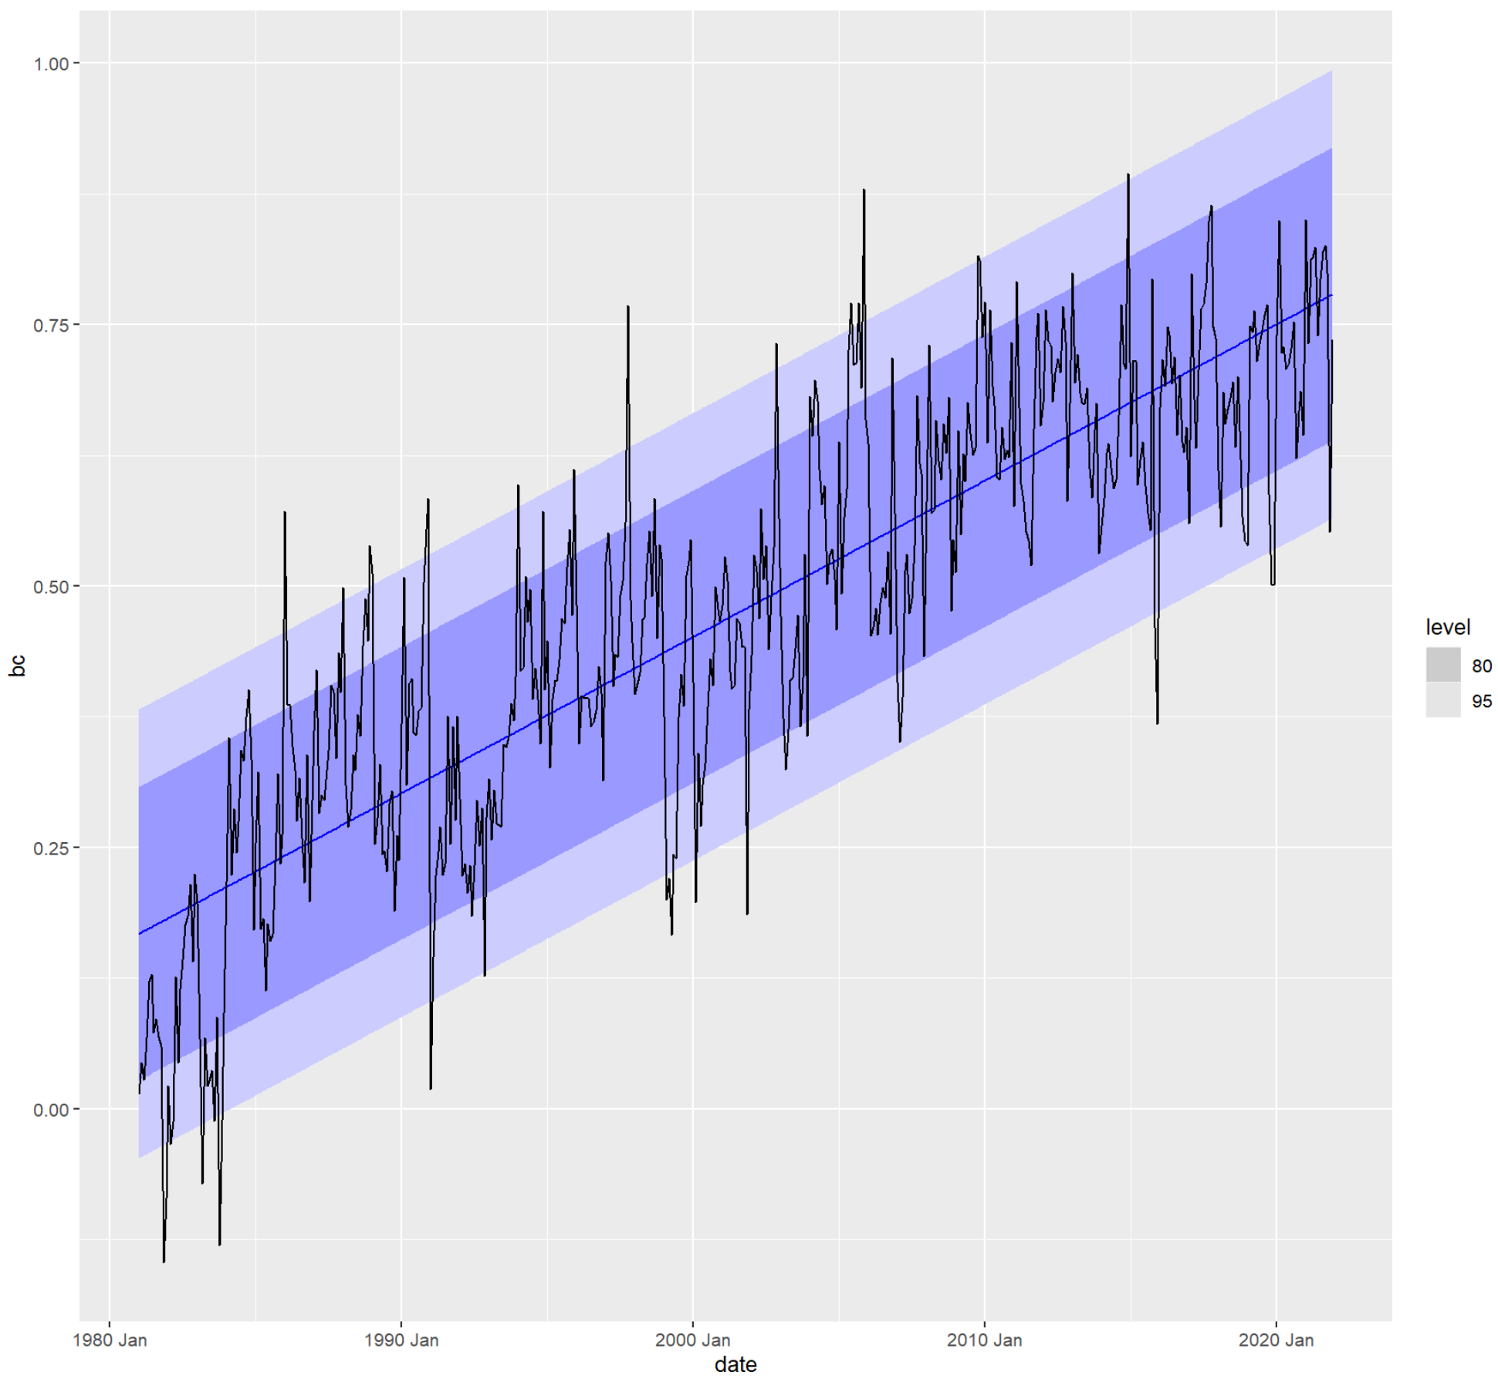
Forecast of the Data
With 95% confidence, our model captures the vast majority of the data.
The model notes that with each increase in month, there is expected to be an increase in credits by about 0.001 (millions)
RMSE, how often is our model wrong?
Value of 1.1 post transformation meaning; Our model’s predictions are typically off by 1.1 credits
73% of the time, our model is able to explain the variation in the Empire’s credit amount.

Slide 5
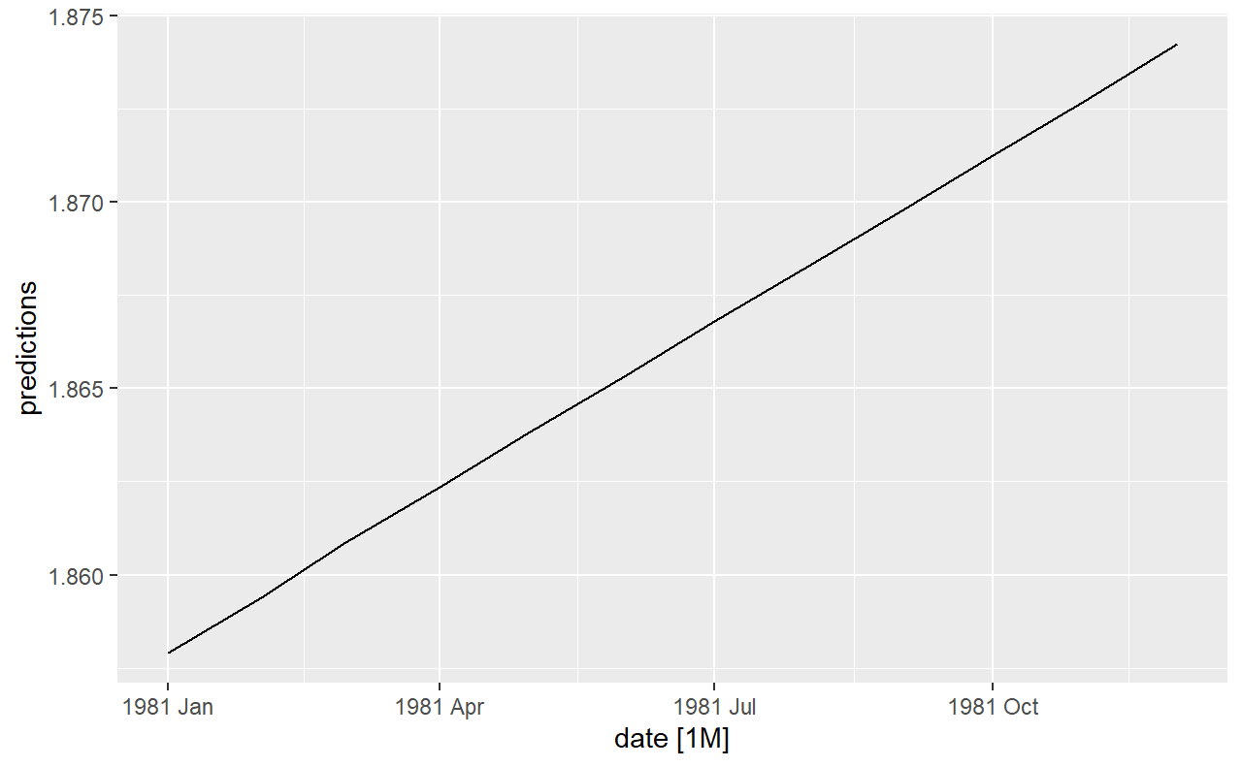
Predictions of Imperial Credit
Our model predicts that Imperial credit will continue to increase over the next 12 months

Slide 6
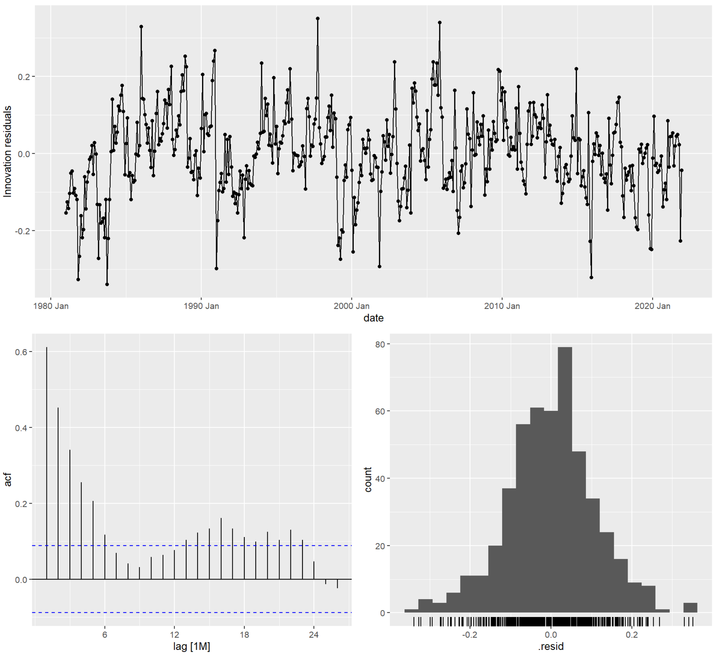
Residuals
The residuals are mostly centered around zero and are white noise as seen in the top plot (no pattern in how the model misses).
This indicates there is not bias.

Slide 7
To conclude…
The Empire can expect that the monthly credits will steadily increase considering the trend of the past 41 years of data.

